Slide 1
Kenya Baseline Transmission Model

Slide 2
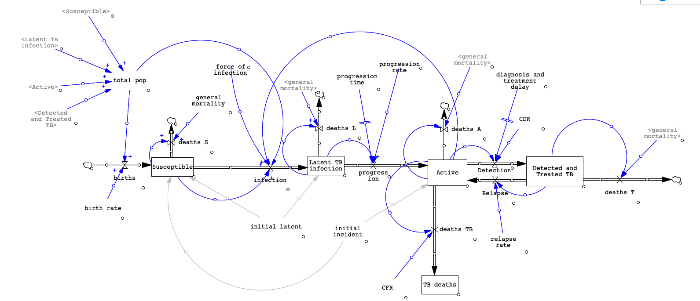
Baseline SFD

Slide 3
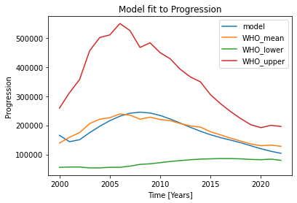
Baseline Calibration
Parameter | Description | Initial guess and calibration Range | Calibration Result
Transmission Rate | Rate at which a susceptible individual may interact with and be infected by an individual with TB | 0.05 (0,0.1) | 0.06356
Relapse Rate | Rate at which a person who has previously been treated with TB experiences diseases reactivation | 0.1 (0.004,0.1) | 0.0083138
Initial incident | The starting number of individuals with active TB in the model | 100 000 (1, 3 000 000) | 1 903 068
Progression rate | The rate at which an individual with latent TB moves to having active TB | 0.08 (0,0.2) | 0.09566
Initial latent | The starting number of individuals with latent TB in the model | 100 000 (1, 3 000 000) | 1 732 038
Potential impact of COVID not modelled

Slide 4
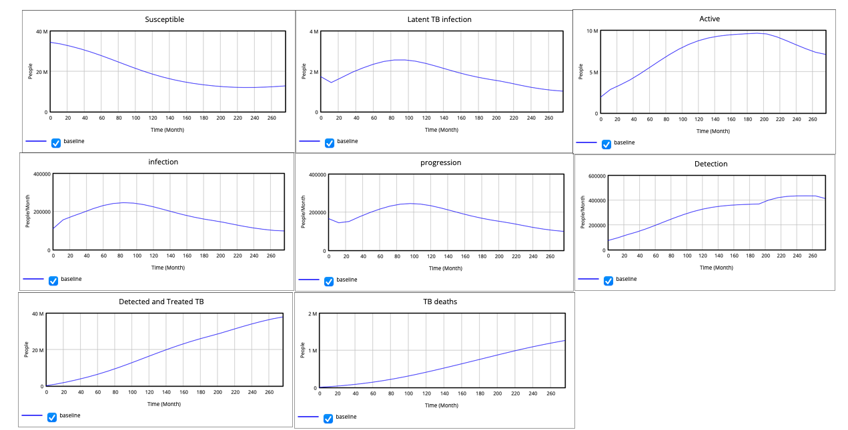
Calibrated Baseline Output

Slide 5
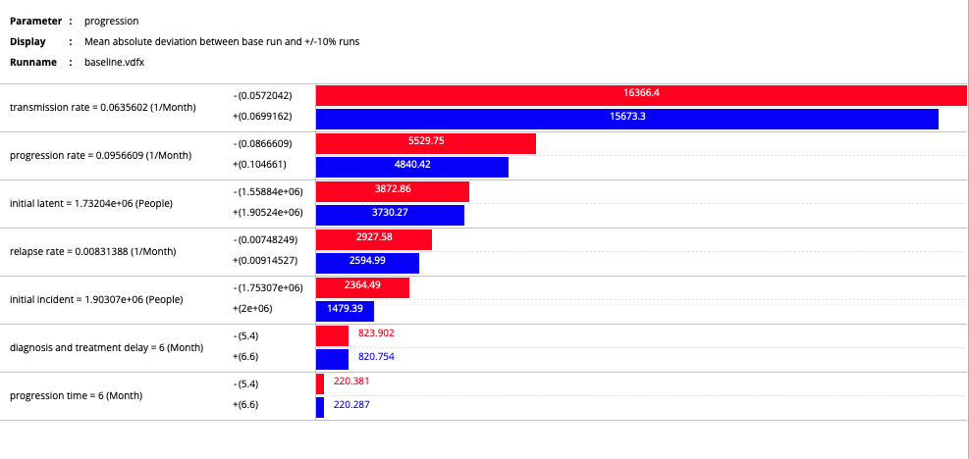
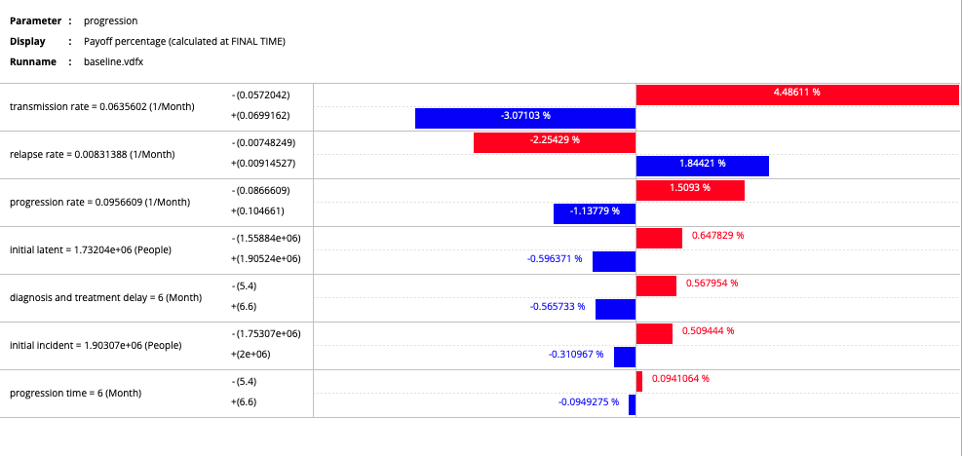
Tornado Plots: Progression

Slide 6
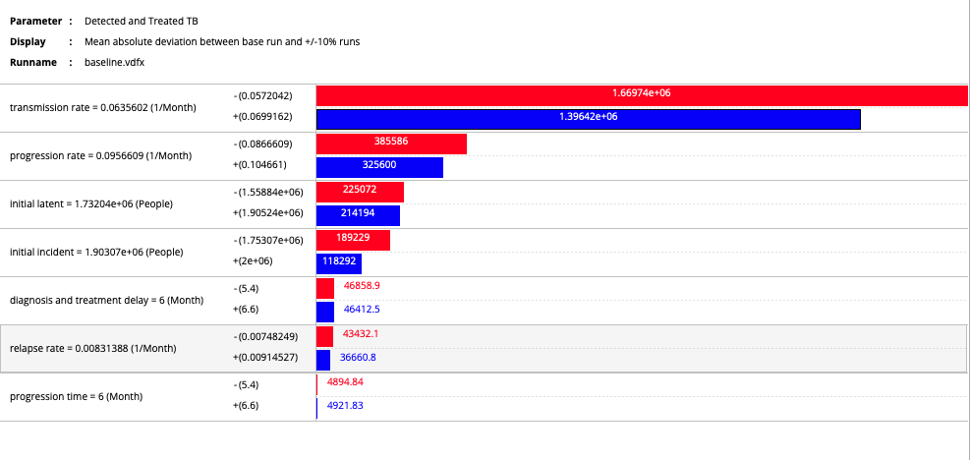
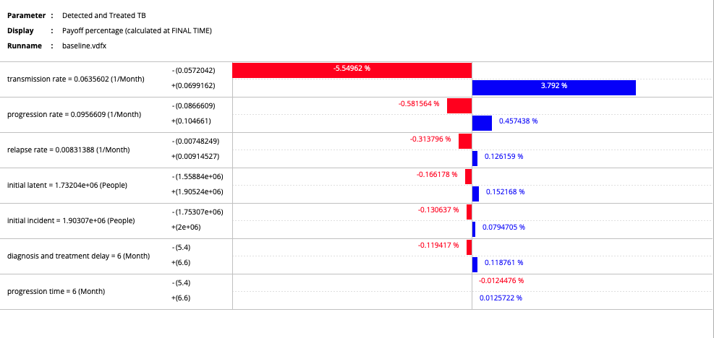
Tornado Plots: Detected and Treated

